Slide 1

RAINFALL

Slide 2
DATASET
Rainfall in India 1901-2015
Sub-division wise monthly rainfall data for 115 years from 1901-2015
Source - https://data.gov.in/catalog/rainfall-india
SAKSHAM YADAV ( 18csu187 )
SALONI YADAV ( 18csu188 )

Slide 3
PROJECT DESCRIPTION
Our Project is made is to make analysis from the data about the RAINFALL in INDIA.
● What is the Average Rainfall Distribution in different sub-division of INDIA
● How is it distributed month wise?
● Has the rainfall shown any considerable change since past 115 years.
● We saw the average Rainfall distribution in Punjab & Haryana states.
● Than , we analysed how the rainfall is distributed in NORTHERN INDIA, EASTERN INDIA, WESTERN INDIA, SOUTHERN INDIA, CENTRAL INDIA & ISLANDS of INDIA.
IN Our dataset The sub-division wise rainfall and its departure from normal for each month and season has been provided, it contains monthly rainfall detail of 36 meteorological sub-divisions of India .

Slide 4
Problem Statement
The Aim of this project is to study the distribution of Average Annual Rainfall in India in different states, in different months and see the difference in its distribution in north south east west central & Islands of India.

Slide 5
Problem Analysis
The fundamental computational issue for this problem is to develop and test and an algorithm for testing various types of hypothesis like t-test, z-test and others using the knowledge of inferential statistics and draw conclusion based on the results obtained.

Slide 6
Problem Design
PROGRAMMING REQUIREMENTS
The requirements of this project are:
The Data Set
Knowledge of Anaconda Python with Jupyter Notebook
Knowledge of various libraries of python (pandas, seaborn etc.)
Knowledge of Descriptive Statistics
Knowledge of Inferential statistics
Formulas (Knowledge) of various tests conduction in hypothesis testing.

Slide 7
Data Input/Output Description
Input
CSV file
Output
Queries & Visualisation

Slide 8
Programming Steps
STEP 1 Import the DataSet (csv file) to the jupyter notebook.
STEP 2 Analyse the DataSet.
STEP 3 Gather the relevant information from the DataSet.
STEP 4 Make the Queries from the information gathered.
STEP 5 Find the solutions of the queries and visualize the result.

Slide 9
Implementation of the Queries
&
its output

Slide 10
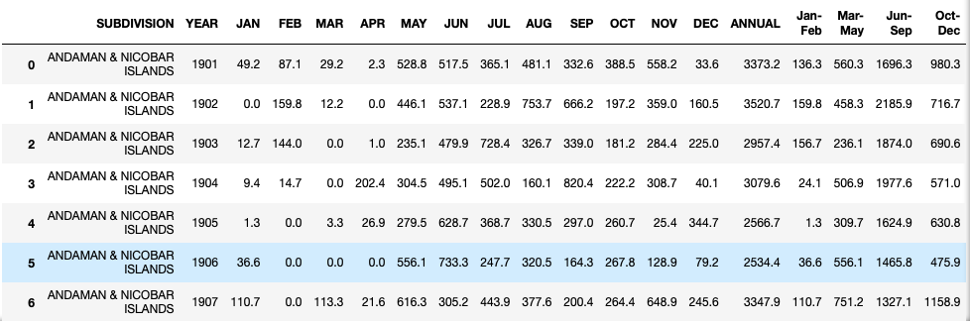
Dataset

Slide 11
Rows and Columns

Slide 12
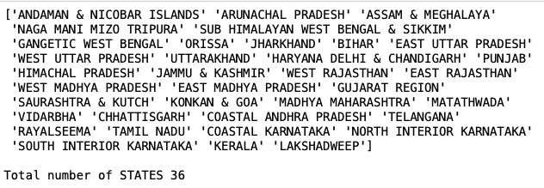
SUB DIVISIONS of INDIA

Slide 13
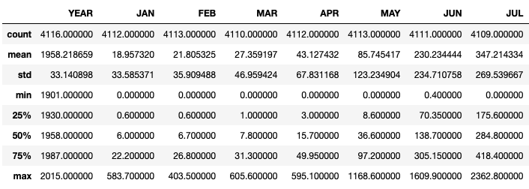

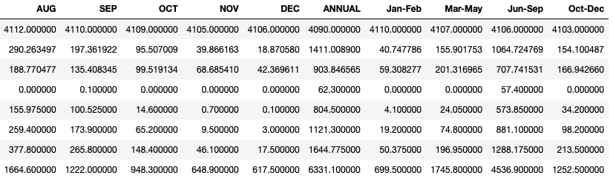
Basic Description

Slide 14
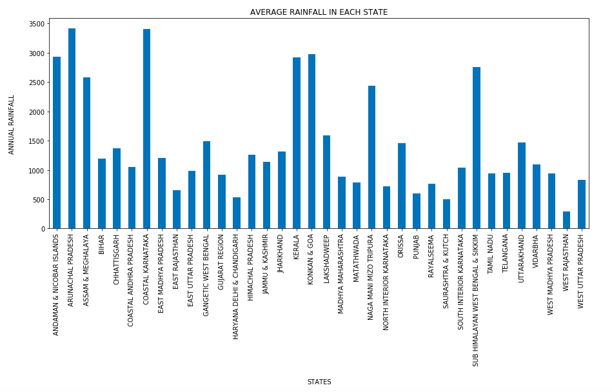
Average Rainfall in each state

Slide 15
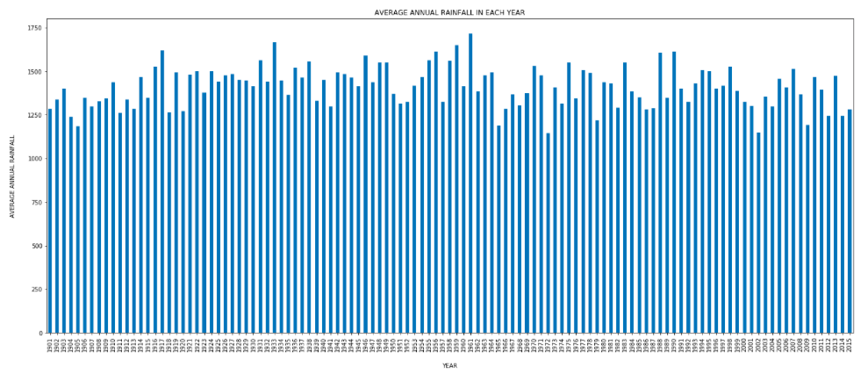

Average Rainfall in each Year

Slide 16
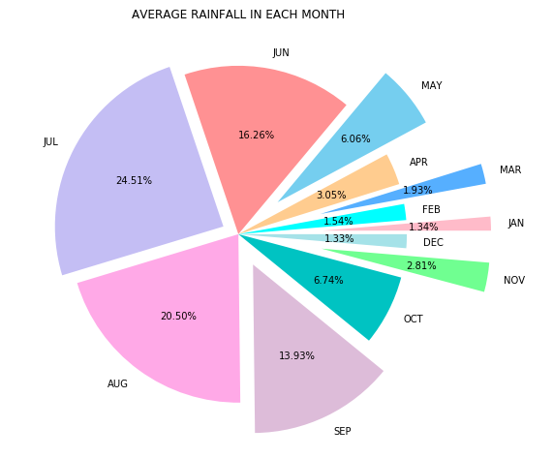
Average Rainfall in each month of the Year

Slide 17
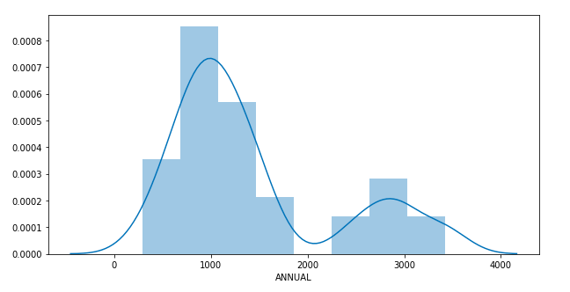
Normal Distribution for the ANNUAL RAINFALL in each state

Slide 18

Average Rainfall in India

Slide 19



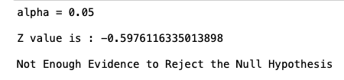
Z TEST

Slide 20


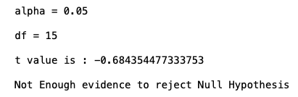
T TEST

Slide 21


CALCULATING CONFIDENCE INTERVAL
Using Z Statistics

Slide 22


CALCULATING CONFIDENCE INTERVAL
Using T Statistics

Slide 23
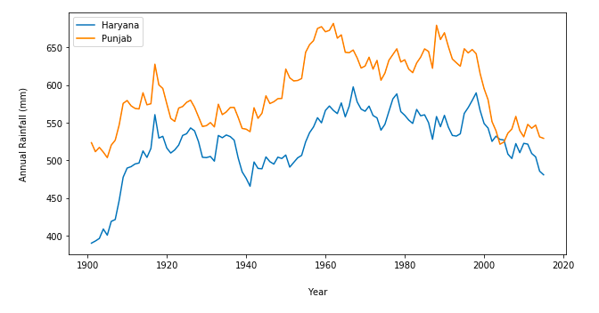
Average Rainfall over the years in PUNJAB & HARYANA DELHI & CHANDIGARH

Slide 24
GEOGRAPHIC DIVISION
NORTH Jammu & Kashmir ,Punjab, Himachal Pradesh, Haryana Delhi & Chandigarh, Uttarakhand, East Uttar Pradesh, West Uttar Pradesh
EAST Gangetic West Bengal, Bihar, Jharkhand, Arunachal Pradesh, Orissa, Assam & Meghalaya,Sub Himalayan West Bengal & Sikkim, Naga Mani Mizo Tripura
WEST East Rajasthan, West Rajasthan, Gujarat Region, Konkan & Goa, Matathwada, Saurashtra & Kutch, Vidharbha, Madhya Maharashtra
SOUTH Tamil Nadu, Telangana, Kerala, Coastal Andra Pradesh, Coastal Karnataka, North Interior Karnataka, South Interior Karnataka, Rayalseema
CENTRAL Chhattisgarh, West Madhya Pradesh, East Madhya Pradesh
ISLANDS Andaman & Nicobar Island, Lakshadweep

Slide 25
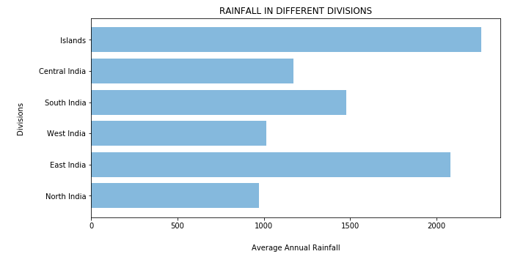
Comparing Rainfall distribution in North, South, East, West, Central and Islands of India

Slide 26
WHAT WE DEPICTED ???
• Arunachal Pradesh have the maximum and West
Rajasthan have the minimum average annual rainfall in India
• It rains maximum in Indian Islands than in others divisions of India
• Average rainfall is maximum in the month of July and minimum in the month of December
• Average Annual rainfall in Punjab is more in comparison to Haryana
• Rainfall suffers Gradual ups and down each year , not consistent

Slide 27


